Slide 1
CS152 Section 7
Branch Prediction, VLIW

Slide 2
Agenda
Branch prediction
Branch history table
Branch target buffer
VLIW
Software pipelining
Lab 3 overview

Slide 3
Administrivia
PS3 due Monday, March 15
Lab 3 due Monday, April 5
Midterm 1 regrade requests open through March 16

Slide 4
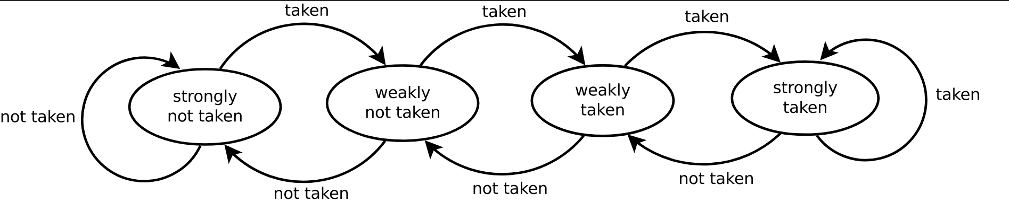
Bimodal Counters
2-bits of state. Upper bit encodes direction
Increment saturating counter for taken, decrement for not-taken
for (int i = 0; i < 4; i++) // BRANCH_A (Taken means stay in the loop)
for (int j = 0; j < 4; j++) // BRANCH_B (Taken means stay in the loop)
if (j % 2) // BRANCH_C (Not taken means perform the body of the if)
sum += i
Assume a BHT indexed by PC, the PCs of the branches do not alias into the same entry
What is the prediction accuracy for each branch with 1-bit counters?
What is the prediction accuracy for each branch with 2-bit counters?

Slide 5
1-bit Bimodal Counters (Q1)
Branch A:
 | i=1 | i=2 | i=3 | i=4
Counter | 0
Prediction
Actual
Assume counters are initialized to 0 (not taken)
for (int i = 0; i < 4; i++) // BRANCH_A
for (int j = 0; j < 4; j++) // BRANCH_B
if (j % 2) // BRANCH_C
sum += i
Branch B:
 | j=1 | j=2 | j=3 | j=4 | j=1 | j=2 | ...
Counter | 0 |  |  |  |  |  | ...
Prediction |  |  |  |  |  |  | ...
Actual |  |  |  |  |  |  | ...
Branch C:
 | j=0 | j=1 | j=2 | j=3 | j=0 | j=1 | ...
Counter | 0 |  |  |  |  |  | ...
Prediction |  |  |  |  |  |  | ...
Actual |  |  |  |  |  |  | ...

Slide 6
2-bit Bimodal Counters (Q1)
Branch A:
 | i=1 | i=2 | i=3 | i=4
Counter | 00
Prediction
Actual
Assume counters are initialized to 00 (strongly not taken)
for (int i = 0; i < 4; i++) // BRANCH_A
for (int j = 0; j < 4; j++) // BRANCH_B
if (j % 2) // BRANCH_C
sum += i
Branch B:
 | j=1 | j=2 | j=3 | j=4 | j=1 | j=2 | ...
Counter | 00 |  |  |  |  |  | ...
Prediction |  |  |  |  |  |  | ...
Actual |  |  |  |  |  |  | ...
Branch C:
 | j=0 | j=1 | j=2 | j=3 | j=0 | j=1 | ...
Counter | 00 |  |  |  |  |  | ...
Prediction |  |  |  |  |  |  | ...
Actual |  |  |  |  |  |  | ...

Slide 7
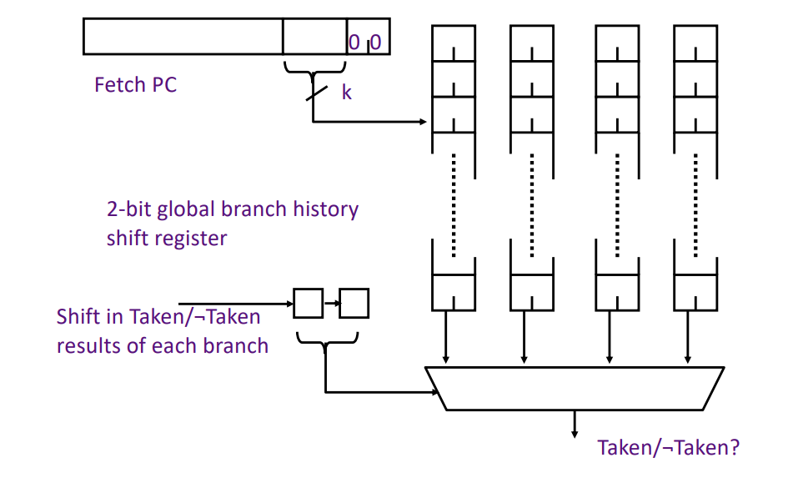
Two-level Predictors
Idea: Dynamic behavior of past branches can be used to predict future branches
Branch history: bitvector of T/NT (1/0) representing dynamic branch history
Combine branch history with PC to select a counter

Slide 8
Two-level Predictors
for (int i = 0; i < 4; i++) // BRANCH_A
for (int j = 0; j < 4; j++) // BRANCH_B
if (j % 2) // BRANCH_C
sum += i
Consider a two-level predictor, where a branch history selects a prediction from multiple PC-indexed counter tables.
Could you design this system to perfectly predict every branch?
If using local histories, how many local history bits?
If using global histories, how many bits of global bits?
 | Predictor policy based on local history | Predictor policy based on global history
BRANCH_A
BRANCH_B
BRANCH_C

Slide 9
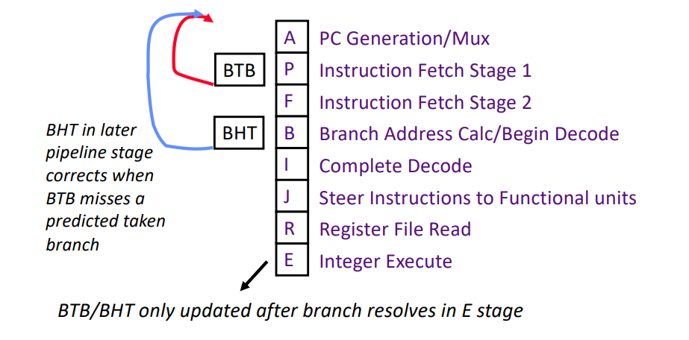
Branch Target Buffers
Branch history tables provide a direction, but what about the target?
May want to redirect branches even before instruction bits are available
Return-address-stack: Push RA on function calls, pop to predict target of a ret

Slide 10
Branch Target Buffers
C code | RISCV asm | What structures can and should learn the behavior of this branch?
for (i=0; i<N; i++) | bne t0, a0, loop
if (err) goto ERROR; | bnez t0, error
goto LABEL; | j LABEL
return; | ret (jalr ra)
switch (x) | jalr x0, t0

Slide 11
VLIW
Multiple parallel operations packed into a single instruction
Each operation slot is dedicated to a fixed function
Resembles horizontal microcode engine
Classic VLIW machines have exposed pipelines with no hardware interlocks
Exploit ILP without complexity of OoO superscalar control logic by shifting burden to compiler
Rely entirely on the compiler to explicitly schedule operations around data hazards
Requires latencies to be statically known
Static scheduling vs dynamic scheduling
Software techniques
Loop unrolling
Software pipelining
Trace scheduling
More information in online Appendix H of H&P textbook (6th edition)

Slide 12
VLIW: Dot Product (Q2)
Label | ALU | MEM | FADD | FMUL
for (i = 0; i < N; i++) C += A[i] * B[i] loop: fld f1, 0(x1) fld f2, 0(x2) fmul f3, f1, f2 fadd f0, f0, f3 addi x1, x1, 8 addi x2, x2, 8 bne x1, x3, loop
All functional units fully pipelined
1-cycle integer ALU
2-cycle load/store unit
3-cycle floating-point adder
4-cycle floating-point multiplier

Slide 13
Software Pipelining
Classic software technique for restructuring loops
Interleaves instructions from different iterations
Works with and without loop unrolling
Dependent operations are separated by one loop body, decreasing stalls
Start-up (prologue) and wind-down (epilogue) code needed before/after loop
Iteration 0
Iteration 1
software-pipelined
iteration
Iteration 2
Iteration 3

Slide 14
Software Pipelining: Dot Product
0
1
2
3
L
L
prologue
*
L
L
pipeline iteration 1
+
*
L
L
pipeline iteration 2
+
*
L
L
+
*
epilogue
+

Slide 15
Software Pipelining: Scalar Version
Iteration i: fadd f0, f0, f3
Iteration i+1: fmul f3, f1, f2
Iteration i+2: fld f1, 0(x1) fld f2, 0(x2) addi x1, x1, 8 addi x2, x2, 8
prologue: ... loop:
fadd f0, f0, f3 fmul f3, f1, f2
fld f1, 0(x1) fld f2, 0(x2) addi x1, x1, 8 addi x2, x2, 8
bne x1, x3, loop epilogue: ...
loop:
fld f1, 0(x1)
fld f2, 0(x2)
fmul f3, f1, f2
fadd f0, f0, f3
addi x1, x1, 8
addi x2, x2, 8
bne x1, x3, loop

Slide 16
Software Pipelining: VLIW
Label | ALU | MEM | FADD | FMUL
 | addi x1 | fld f1
 | addi x2 | fld f2
 | addi x1 | fld f1 |  | fmul f3
 | addi x2 | fld f2
loop: | addi x1 | fld f1 |  | fmul f3
 | addi x2 | fld f2 | fadd f0
 | bne loop
 |  |  |  | fmul f3
 |  |  | fadd f0
 |  |  | fadd f0
loop:
fld f1, 0(x1)
fld f2, 0(x2)
fmul f3, f1, f2
fadd f0, f0, f3
addi x1, x1, 8
addi x2, x2, 8
bne x1, x3, loop
1-cycle integer ALU
2-cycle load/store unit
3-cycle floating-point adder
4-cycle floating-point multiplier
Assume perfect branch prediction

Slide 17
Software Pipelining + Unrolling
loop:
fld f4, 0(x1)
fld f5, 0(x2)
fld f6, 8(x1)
fld f7, 8(x2)
fld f8, 16(x1)
fld f9, 16(x2)
fld f10, 24(x1)
fld f11, 24(x2)
fmul f12, f4, f5
fmul f13, f6, f7
fmul f14, f8, f9
fmul f15, f10, f11
fadd f0, f0, f12
fadd f1, f1, f13
fadd f2, f2, f14
fadd f3, f3, f15
addi x1, x1, 32
addi x2, x2, 32
bne x1, x3, loop
Unroll loop 4 times
Accumulate 4 partial sums in parallel (f0, f1, f2, f3)
Reduce at end (not shown)
Assume VLIW machine has second load/store unit
Dot product has 1:1 ratio between loads and FLOPs
Yields optimal throughput of 2 FLOPs/cycle

Slide 18
Label | INT | MEM0 | MEM1 | FADD | FMUL
 | addi x1,x1,32 | fld f4,0(x1) | fld f5,0(x2)
 | addi x2,x2,32 | fld f6,-24(x1) | fld f7,8(x2)
 |  | fld f8,-16(x1) | fld f9,-16(x2)
 |  | fld f10,-8(x1) | fld f11,-8(x2)
 | addi x1,x1,32 | fld f4,0(x1) | fld f5,0(x2) |  | fmul f12,f4,f5
 | addi x2,x2,32 | fld f6,-24(x1) | fld f7,8(x2) |  | fmul f13,f6,f7
 |  | fld f8,-16(x1) | fld f9,-16(x2) |  | fmul f14,f8,f9
 |  | fld f10,-8(x1) | fld f11,-8(x2) |  | fmul f15,f10,f11
loop: | addi x1,x1,32 | fld f4,0(x1) | fld f5,0(x2) | fadd f0,f0,f12 | fmul f12,f4,f5
 | addi x2,x2,32 | fld f6,-24(x1) | fld f7,8(x2) | fadd f1,f1,f13 | fmul f13,f6,f7
 |  | fld f8,-16(x1) | fld f9,-16(x2) | fadd f2,f2,f14 | fmul f14,f8,f9
 | bne x1,x3,loop | fld f10,-8(x1) | fld f11,-8(x2) | fadd f3,f3,f15 | fmul f15,f10,f11
 |  |  |  | fadd f0,f0,f12 | fmul f12,f4,f5
 |  |  |  | fadd f1,f1,f13 | fmul f13,f6,f7
 |  |  |  | fadd f2,f2,f14 | fmul f14,f8,f9
 |  |  |  | fadd f3,f3,f15 | fmul f15,f10,f11
 |  |  |  | fadd f0,f0,f12
 |  |  |  | fadd f1,f1,f13
 |  |  |  | fadd f2,f2,f14
loop:
fld f4, 0(x1)
fld f5, 0(x2)
fld f6, 8(x1)
fld f7, 8(x2)
fld f8, 16(x1)
fld f9, 16(x2)
fld f10, 24(x1)
fld f11, 24(x2)
fmul f12, f4, f5
fmul f13, f6, f7
fmul f14, f8, f9
fmul f15, f10, f11
fadd f0, f0, f12
fadd f1, f1, f13
fadd f2, f2, f14
fadd f3, f3, f15
addi x1, x1, 32
addi x2, x2, 32
bne x1, x3, loop

Slide 19
Lab 3 Overview

Slide 20
BOOM: Berkeley Out-of-Order Machine
Open-source, synthesizable, out-of-order superscalar RISC-V core
Heavily inspired by the MIPS R10000 and Alpha 21264
Unified physical register file with explicit renaming
Split ROB / issue window design
Extensively parameterized:
Fetch and issue widths, ROB size, LSU size
Functional unit mix, latencies
Issue scheduler
Composable branch predictors, RAS size, BTB size
Commit map table (R10k rollback vs Alpha 21264 single-cycle flush)
Maximum in-flight branches

Slide 21
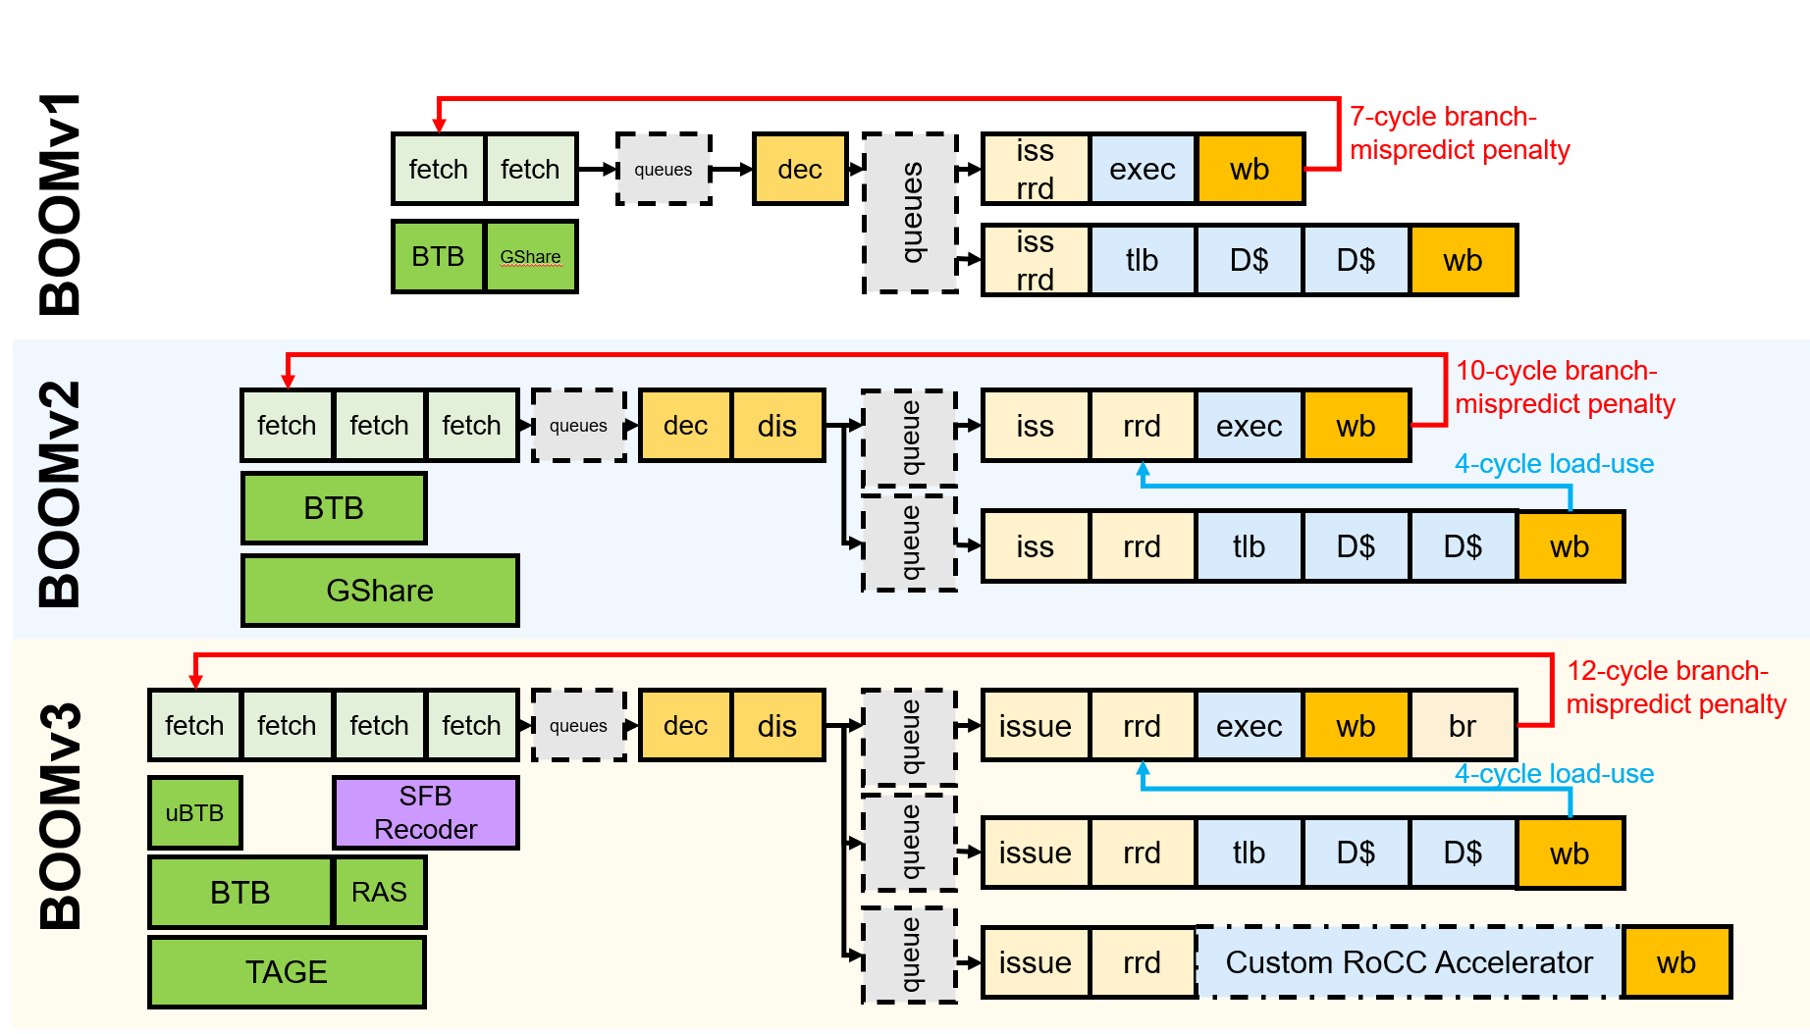
BOOM: Berkeley Out-of-Order Machine

Slide 22
Open-Ended: Branch predictor design
Implement a branch predictor in C++ that integrates with BOOM
Objective is to beat baseline implementation of BHT
Also compare against BOOM’s fine-tuned HW branch predictors
Gradescope autograder tests IPC and accuracy:
Winning team receives 10% extra credit
Limited division: Constrained to 64 KiB of storage, plus 2048 bits of additional budget
Open division: No restrictions

Slide 23
Open-Ended: Spectre attacks
Spectre/Meltdown: Microarchitectural side-channel attacks that exploit branch prediction, speculative execution, and cache timing to bypass security mechanisms
Objective is to recreate Spectre attacks on BOOM
Attack scenario
Vulnerable Spectre gadget present in supervisor syscall code
Write user program to infer secret data from protected kernel memory using branch predictor mis-training and cache side effects
Gradescope autograder tests throughput and accuracy
Team that can guess most bits correctly in allotted time receives 10% extra credit

